Slide 1

Data Structures and its Applications
Dinesh Singh
Department of Computer Science & Engineering

Slide 2

Data structures and its applications
Priority Queue - Implementation
Dinesh Singh
Department of Computer Science & Engineering

Slide 3
Data Structures and its Applications
Priority Queues - definition
Priority Queue is an extension of queue where every item has a priority associated with it.
There are two types of priority queue
Ascending priority queue
Descending Priority queue
In Ascending Priority queue ,the item with lowest priority is removed
In descending priority queue, the item with the highest priority is removed.

Slide 4
Data Structures and its Applications
Priority queues - Operations
Operations in Ascending priority queue
pqinsert(apq,x) : inserts element x into the priority queue apq.
pqmindelete(apq) : removes the element with the minimum priority.
Operations in Descending priority queue
pqinsert(dpq,x) : inserts element x into the priority queue dpq.
pqmaxdelete(dpq) : removes the element with the maximum priority.
The operation empty(pq) determines whether the queue is empty or not.

Slide 5
Data Structures and its Applications
Priority Queues- alternate definition
In alternate definition of a priority queue, the items do not have a priority but the intrinsic ordering of elements determine results of its basic operation.
In ascending priority queue, items can be inserted arbitrarily, but only the smallest element can be removed.
In descending priority queue, items can be inserted arbitrarily, but only the largest element can be removed.

Slide 6
Data Structures and its Applications
Priority Queues- Implementation
Priority queues can be implemented by
Arrays
Linked Lists
Heap

Slide 7
Data Structures and its Applications
Priority Queues- Array Implementation
struct pqueue
{
int data;
int pty;
}
struct pqueue pq[10];
implementation of descending priority :
Items inserted based on their priority
Insert : The item is inserted based on its priority. The queue is ordered in the descending priority of the items. The item with the highest priority will be at the first location in the array.
Remove : delete always the first element, Shift the other elements to the left after the deletion

Slide 8
Data Structures and its Applications
Priority Queues- Array Implementation
implementation of descending priority :
Items inserted arbitrarily
Insert : The item is inserted at the rear of the queue. The queue is therefore unordered.
Delete : The item with the highest priority is found and removed. The items following the position of the removed element are shifted to the left.

Slide 9
Data Structures and its Applications
Priority Queues- Array Implementation
implementation of descending priority where items are inserted according to the priority
void pqinsert(int x,int pty,struct pqueue *pq,int *count)
{
// x is item to be inserted
// pty is the priority of the item
// pq is the pointer to the priority queue
// count is the number of items in the queue
int j;
struct pqueue key;
key. data=x;
key.pty=pty;

Slide 10
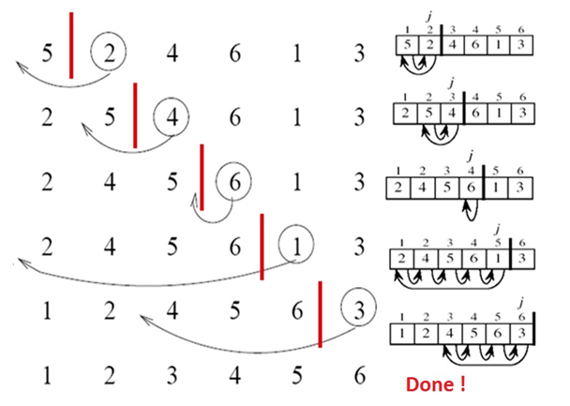
Data Structures and its Applications
Priority Queues- Array Implementation
implementation of descending priority where items are inserted according to the priority
j=*count-1; // index of the initial position of the element
//compare the priority of the item being inserted with the
//priority of the items in the queue
// shift the items down while the priority of the item being
//inserted is greater than priority of the item in the queue
while((j>=0)&&(pq[j].pty>key.pty))
{
pq[j+1]=pq[j];
j--;
}
pq[j+1]=key; // insert the element at its correct location
(*count)++;
}

Slide 11
Data Structures and its Applications
Priority Queues- Array Implementation
implementation of descending priority where items are inserted according to the priority
struct pqueue pqdelete(struct pqueue *pq,int *count)
{
// pq is a pointer to the priority queue
// count is the number of elements in the queue
int i;
struct pqueue key;
// if queue is empty, return a structure with priority -1
if(*count==0)
{
key.data=0;
key.pty=-1;
}

Slide 12
Data Structures and its Applications
Priority Queues- Array Implementation
implementation of ascending priority where items are inserted according to the priority
//delete the first item
//shift the other items to the left
else
{
key=pq[0];
for(i=1;i<=*count-1;i++)
pq[i-1]=pq[i];
(*count)--;
}
return key; //return the key with the lowest priority
}

Slide 13
Data Structures and its Applications
Priority Queues- Array Implementation
Implement the following
Ascending Priority queue where item is inserted at the end and item with the lowest priority is deleted.
Descending priority queue
Ascending and Descending Priority queue using a linked list

Slide 14
THANK YOU
Dinesh Singh
Department of Computer Science & Engineering
dineshs@pes.edu
+91 8088654402

